Slide 1

CCSIC FUEL EMISSIONS REDUCTION TRAINING
SIC Best Practices Webinar | November 12, 2025

Slide 2
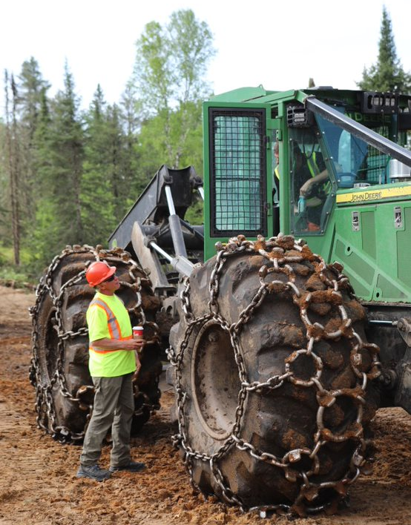

Objective 9. climate smart forestry
Performance Measure 9.2. Certified Organizations shall individually and/or through cooperative efforts involving SFI Implementation Committees or other partners identify and address opportunities to mitigate the effects associated with its forest operations on climate change.
Indicator 9.2.3. Based on best scientific information, Certified Organizations shall develop a program to identify and address greenhouse gas emissions within their operational control.
2

Slide 3
FUEL EMISSIONS REDUCTION TRAINING PACKAGE
Partnership with FPInnovations
Training Module
Share best practices to help contractors and operators improve their performance in terms of fuel efficiency and emissions.
Powerpoint version – can be delivered by anyone, and a recorded version delivered by Dean Caron of FPInnovations.
Field Bulletins
  One for harvesting operations and one for transportation.
  Designed to be quick tailgate session or a resource to keep in machines.
Section #1: Introduction to Fuel Efficiency and Emissions
Section #2: Fuel and Energy Management
Section #3: Harvesting Operations – Factors Influencing Fuel Consumption and Emissions
Section #4: Transportation – Factors Influencing Fuel Consumption and Emissions
Section #5: Understanding Cost Impacts of Machine Utilization, Productivity, Fuel Costs and Logging Chance
Section #6: Wrap Up and Key Messages

Slide 4
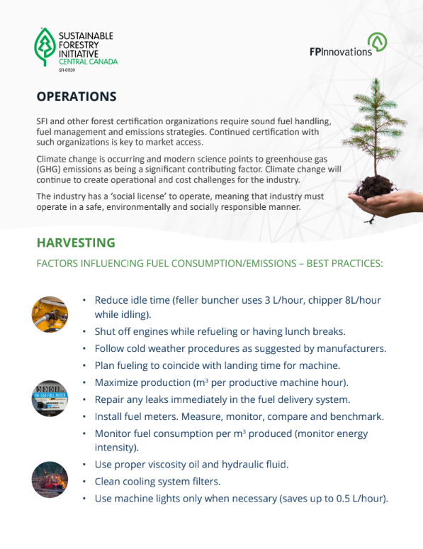
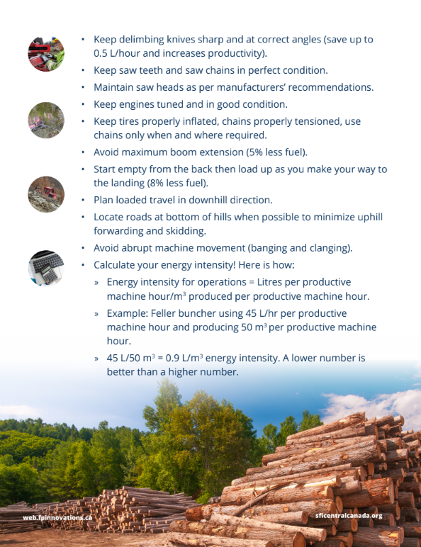
FIELD Bulletins
Harvesting

Slide 5
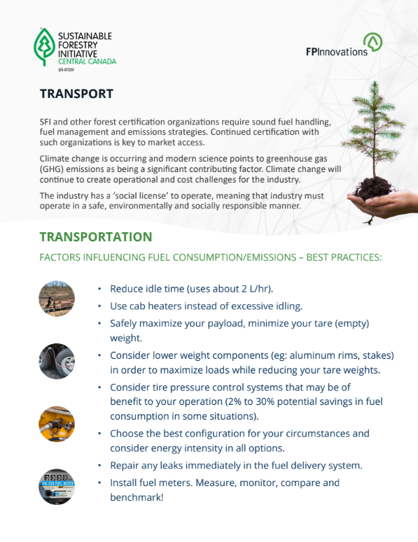
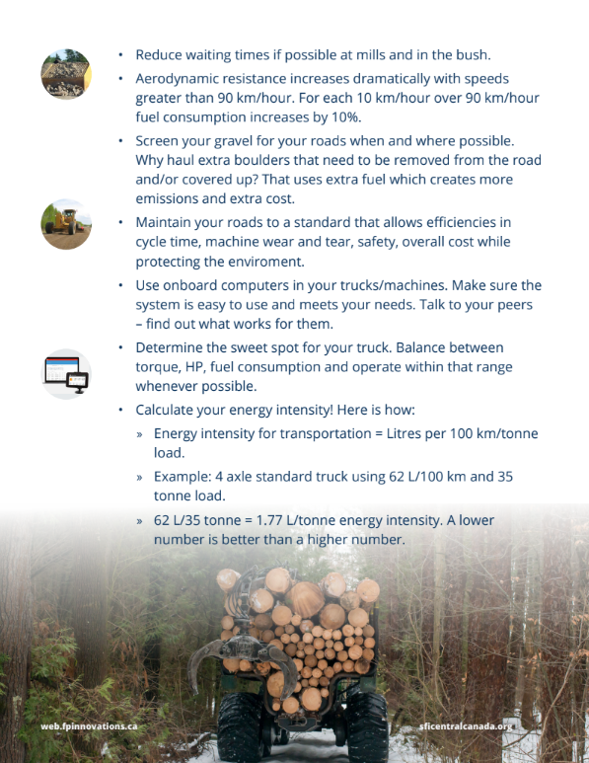
FIELD Bulletins
Transportation

Slide 6
Questions?
Madelaine.kennedy@weyerhaeuser.com

